Slide 1

Data structure week Five
Contact Details:
Email: sobia.iftikhar@nu.edu.pk
GCR:

Slide 2
Outline
Elementary Sorting Techniques
Insertion Sorting
Bubble Sorting

Slide 3
Class One

Slide 4
Insertion Sort
Insertion sort is a sorting algorithm that places an unsorted element at its suitable place in each iteration.
Insertion sort works similarly as we sort cards in our hand in a card game.
We assume that the first card is already sorted then, we select an unsorted card. If the unsorted card is greater than the card in hand, it is placed on the right otherwise, to the left. In the same way, other unsorted cards are taken and put in their right place.
A similar approach is used by insertion sort.

Slide 5
Show me an example of Insertion Sort
the sorted
sub-array
22 | 5 | 4 | 17 | 8 | -1
 |  |  |  |  | 8 | -1
4 | 5 | 22 | 17
4 | 5 | 8 | 17 | -1 | 22
0 1 2 3 4 5
0 1 2 3 4 5
0 1 2 3 4 5
 |  |  | 4 | 17 | 8 | -1
22 | 5
 |  |  |  |  | 8 | -1
4 | 5 | 17 | 22
4 | 5 | 8 | -1 | 17 | 22
0 1 2 3 4 5
0 1 2 3 4 5
0 1 2 3 4 5
 |  |  | 4 | 17 | 8 | -1
5 | 22
 |  |  |  |  |  | -1
4 | 5 | 17 | 22 | 8
4 | 5 | -1 | 8 | 17 | 22
0 1 2 3 4 5
0 1 2 3 4 5
0 1 2 3 4 5
5 | 22 | 4 | 17 | 8 | -1
 |  |  |  |  |  | -1
4 | 5 | 17 | 8 | 22
4 | -1 | 5 | 8 | 17 | 22
0 1 2 3 4 5
0 1 2 3 4 5
0 1 2 3 4 5
5 | 4 | 22 | 17 | 8 | -1
 |  |  |  |  |  | -1
4 | 5 | 8 | 17 | 22
-1 | 4 | 5 | 8 | 17 | 22
done
0 1 2 3 4 5
0 1 2 3 4 5
0 1 2 3 4 5
4 | 5 | 22 | 17 | 8 | -1
4 | 5 | 8 | 17 | 22 | -1
0 1 2 3 4 5
0 1 2 3 4 5

Slide 6
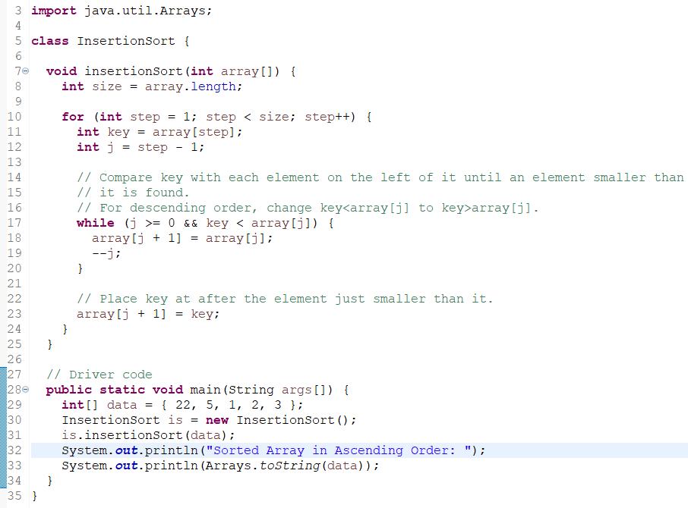

Implementation

Slide 7
Bubble Sort
Bubble sort is a sorting algorithm that compares two adjacent elements and swaps them until they are in the intended order.
Just like the movement of air bubbles in the water that rise up to the surface, each element of the array move to the end in each iteration. Therefore, it is called a bubble sort.

Slide 8
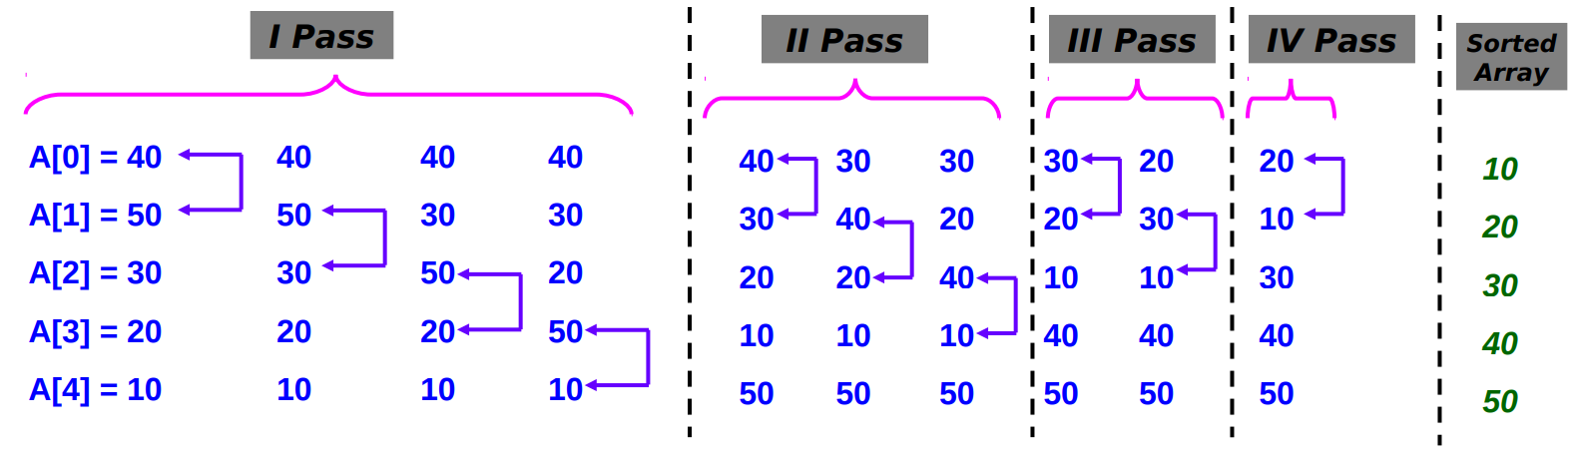
Implementation
Suppose we have a list of array of 5 elements A[5]={40,50,30,20,10}. We have to sort this array using bubble sort algorithm.
For I = 0 to N - 2
For J = 0 to N - 2
If (A(J) > A(J + 1)
Temp = A(J)
A(J) = A(J + 1)
A(J + 1) = Temp
End-If
End-For
End-For

Slide 9
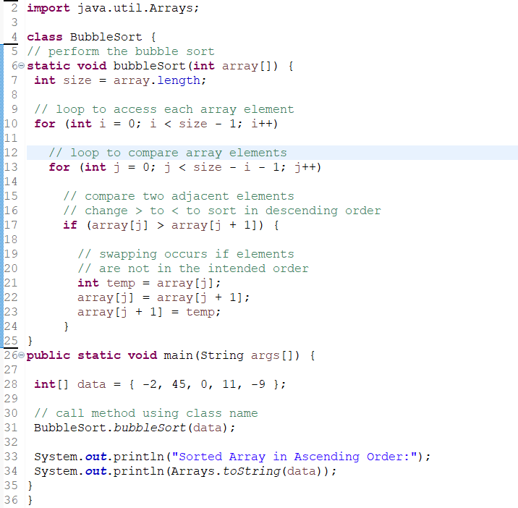
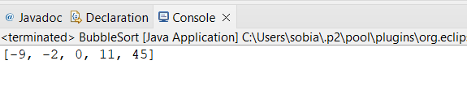
Implementation

Slide 10
In insertion sort elements are bubbled into the sorted section, while in bubble sort the maximums are bubbled out of the unsorted section.

Slide 11
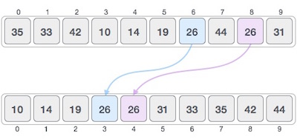
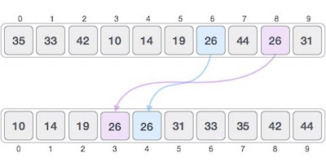
Stable and Not Stable Sorting
If a sorting algorithm, after sorting the contents, does not change the sequence of similar content in which they appear, it is called stable sorting.
A sorting algorithm is considered stable if the two or more items with the same value maintain the same relative positions even after sorting.
If a sorting algorithm, after sorting the contents, changes the sequence of similar content in which they appear, it is called unstable sorting.

Slide 12
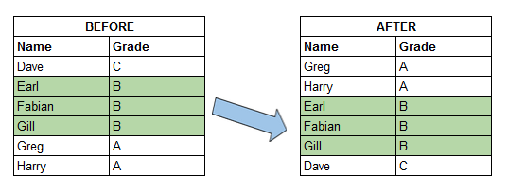
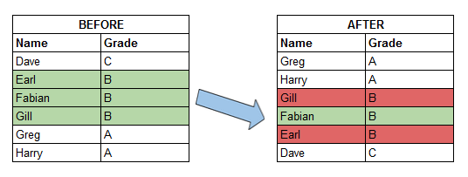

Slide 13
few common sorting algorithms and their stability:
Insertion Sort — Stable
Selection Sort — Unstable
Bubble Sort — Stable
Sorting Algorithm | Stability
Bubble Sort | Yes
Selection Sort | No
Insertion Sort | Yes

Slide 14
Insertion Sort Stability
Example:
5,5,2,2,3
10, 2,1,7,100,1

Slide 15
Adaptive and non- Adaptive
Those sorting algorithms which do not waste their time on sorted elements and use their all resource to sort the unsorted elements are known as Adaptive sorting algorithms.
A Non-Adaptive Sorting Algorithm does not care if the array is already sorted or not it will apply its all resources to sort the sorted elements.
Adaptive sorting algorithms: 1. Bubble Sort 2. Insertion Sort 3. Quick Sort
Non-adaptive sorting algorithms: 1. Selection Sort 2. Merge Sort 3. Heap Sort

Slide 16
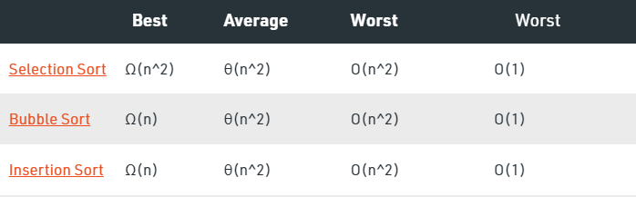
Insertion Sort
Time complexity
O(n^2)
Space Complexity
O(1)

Slide 17
Properties of Sorting Algorithms
Algorithm | Adaptive | Stable | In-place
Bubble Sort | No | Yes | Yes
Selection Sort | No | No | Yes
Insertion Sort | Yes | Yes | Yes
Shell Sort | Yes | No | Yes

Slide 18
Efficient/Advance sorting techniques
Shell Sort
Heap sort
Quick Sort
Merge Sort
Radix Sort
Counting Sort

